Slide 1
Predicting Review Score Based on Review Text with CNNs
By CDTs Hernon, Owen, Rennie, and Persteins

Slide 2
Agenda
Data
CNN Structure
Results
Hyperparameter Tuning
Future Improvements

Slide 3

Data Gathering and Preparation
Retrieved data from kaggle
Data consists of reviews from Amazon
Reviews categorized by product.
Several columns: ID, score, summary, etc.

Slide 4

Data Preprocessing
Packages Utilized
NLTK
Sklearn
Tensorflow
Function "clean_text()" made
Utilized re.sub to aid in removing punctuation and special characters
TfidF Vectorizer
Removes English stop words

Slide 5
Model Building and Training
Padded words to 200 tokens, and replaced with ‘UNK’ if needed
First used a Convolution with 128 filters, kernel size of 5, and relu activation function
Then applied a dense layer with 128 nodes and relu function
Finally applied a dense layer with 5 nodes and softmax activation function to return probabilities for the 5 scores

Slide 6
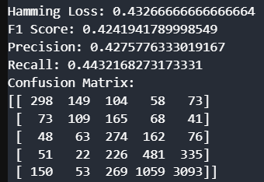
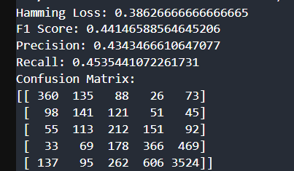
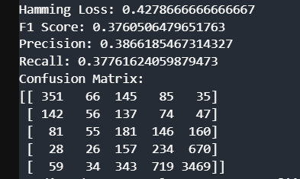
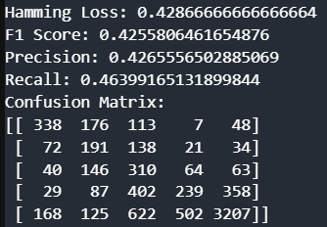
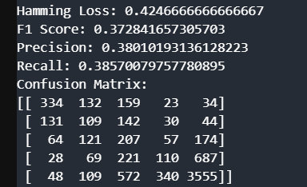
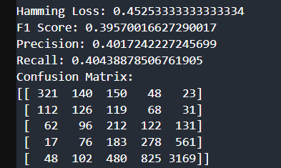
Model Evalutation and Optimization
No dropout, kernel of size 3
Dropout, kernel of 5
No Dropout, 256 filters
No Dropout, 64 filters
No dropout, kernel of size 5
No dropout, kernel of size 7

Slide 7
Model Performance Summary
Hamming Loss: ~0.42
F1 Score: ~0.43
Precision: ~0.43
Recall: ~0.45
Key takeaway: Model exhibits moderate performance but struggles with certain classes
Opportunities for optimization

Slide 8
Confusion Matrix Explanation
Model tends to confuse specific classes (3, 4)
Predicted: 1 | Actual: 3 | Sentence: "Im always on the lookout..."
Predicted: 4 | Actual: 3 | Sentence: "Tried a snack, looked healthy..."

Slide 9
Reporting Results and Insights
Challenges:
Overfitting observed.
Misclassifications in similar sentiment categories.
Future Work:
Explore attention mechanisms to better capture contextual nuances.
Augment data for underrepresented classes.
Optimize hyperparameters for better generalization.

